Slide 1
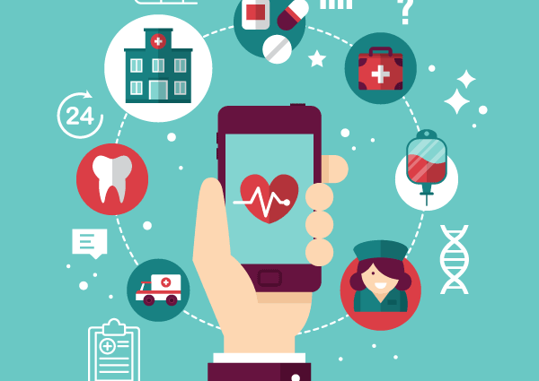
Maximizing prevention though informatics: In diabetic management
Sucharitha Dammareddygari
Suhani Yalaga
This Photo by Unknown Author is licensed under CC BY-SA

Slide 2
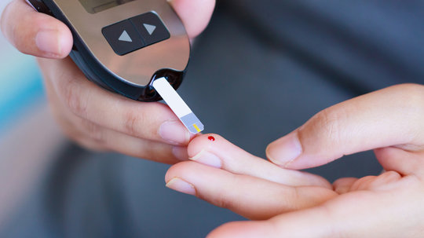
Introduction
Diabetes affects many people globally, mostly Type 2. Keeping blood sugar levels in check is crucial to avoid serious health problems and even death. But it's hard and expensive to do this all the time. We need new ways for people to take care of themselves better. Health technology, like apps and gadgets, can help make healthcare easier and cheaper. That's where digital health comes in. It uses technology to improve how we manage diseases like diabetes. This field is growing fast, with over $4.5 billion invested in 2015.

Slide 3
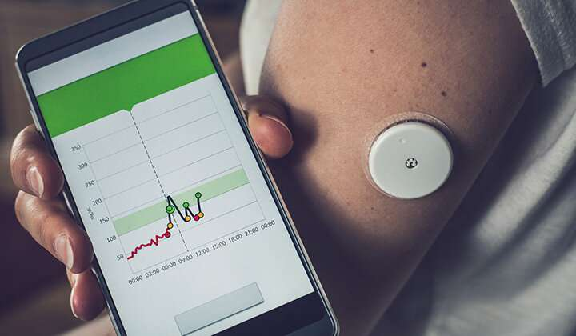
Target population
Individuals diagnosed with type 2 diabetes (T2D).
People at risk of developing type 2 diabetes, including prediabetic individuals.
Healthcare providers involved in the care and management of diabetes patients, including physicians, nurses, dietitians, and pharmacists.
Caregivers and family members of individuals living with diabetes who are involved in their day-to-day management and support.
Public health organizations and policymakers involved in diabetes prevention and management strategies.
Insurance providers and healthcare payers seeking to improve outcomes and reduce costs associated with diabetes care.
Researchers and developers working on the advancement of digital health technologies for diabetes management

Slide 4

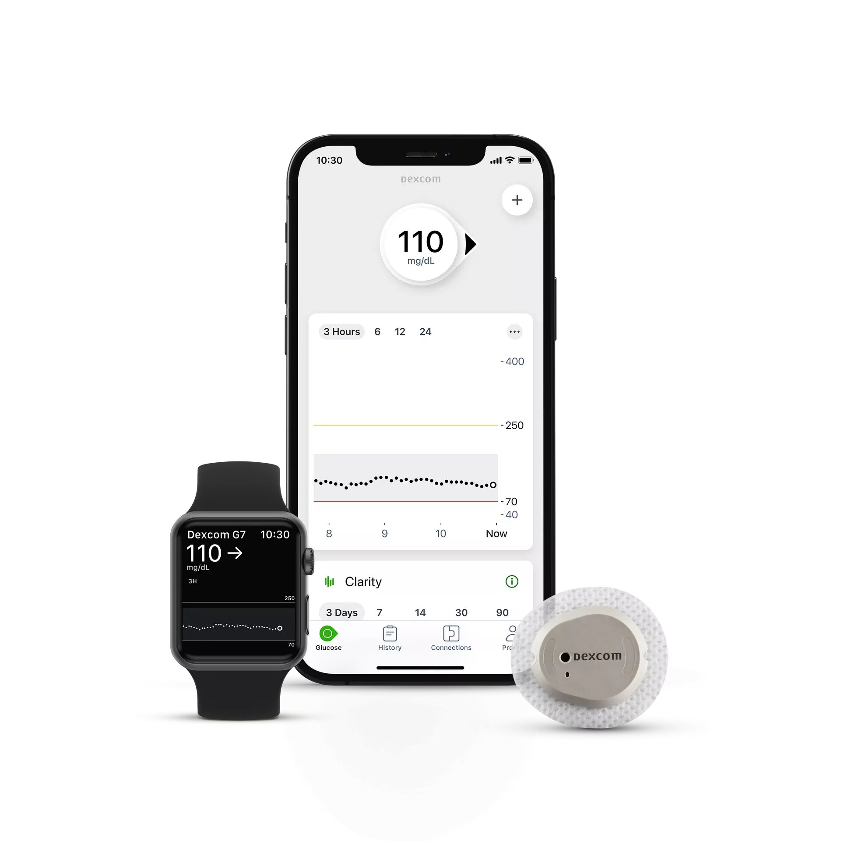
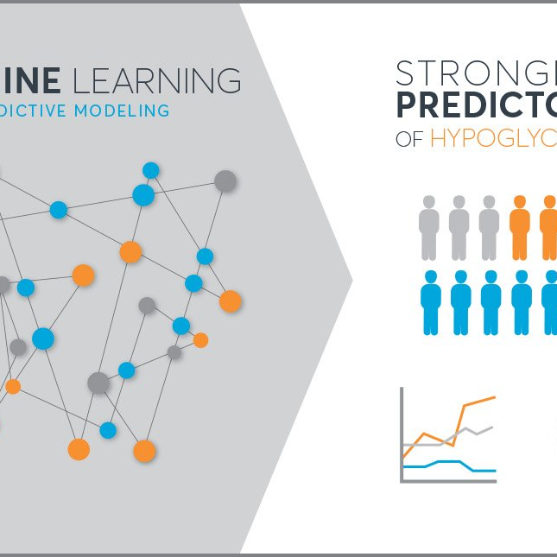
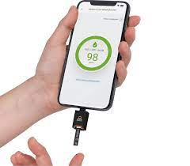

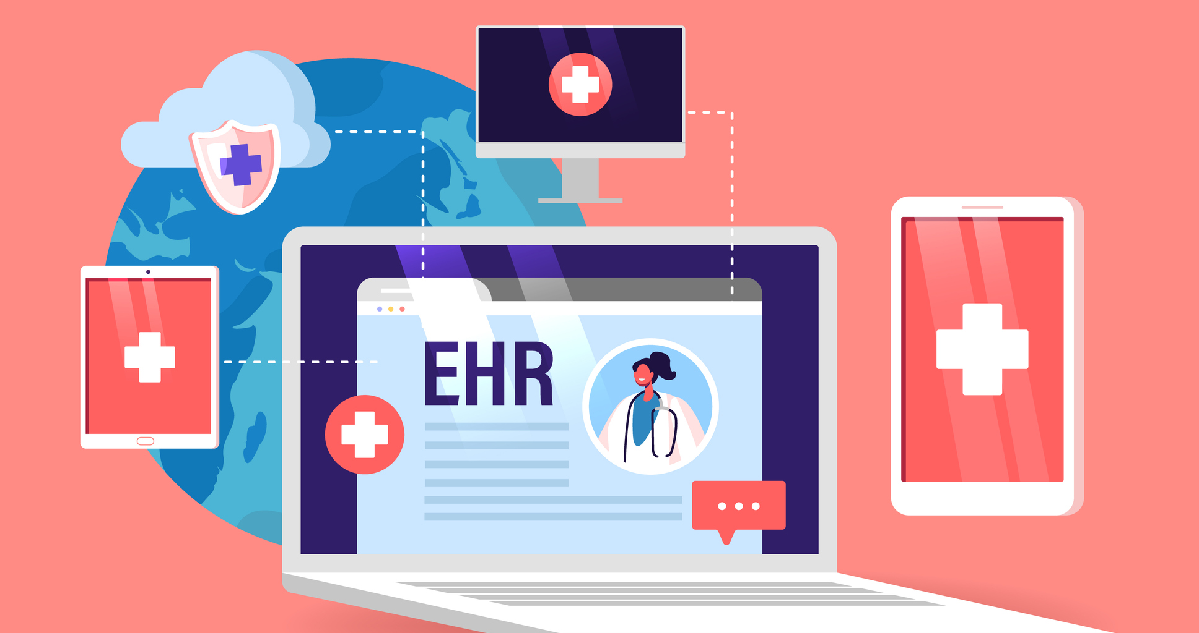
Different areas where we use HIT in diabetic care
Mobile Applications and Personalizing Interventions for Lifestyle Modifications.
Wearable Devices (Continuous Glucose Monitoring)
Continuous Subcutaneous Injection
Electronic Health Records (EHR)
Telemedicine Platform for Diabetics
Predictive Modeling
Remote Monitoring Using Health Information Technology

Slide 5

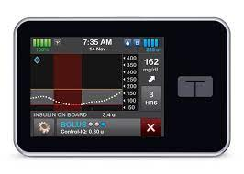
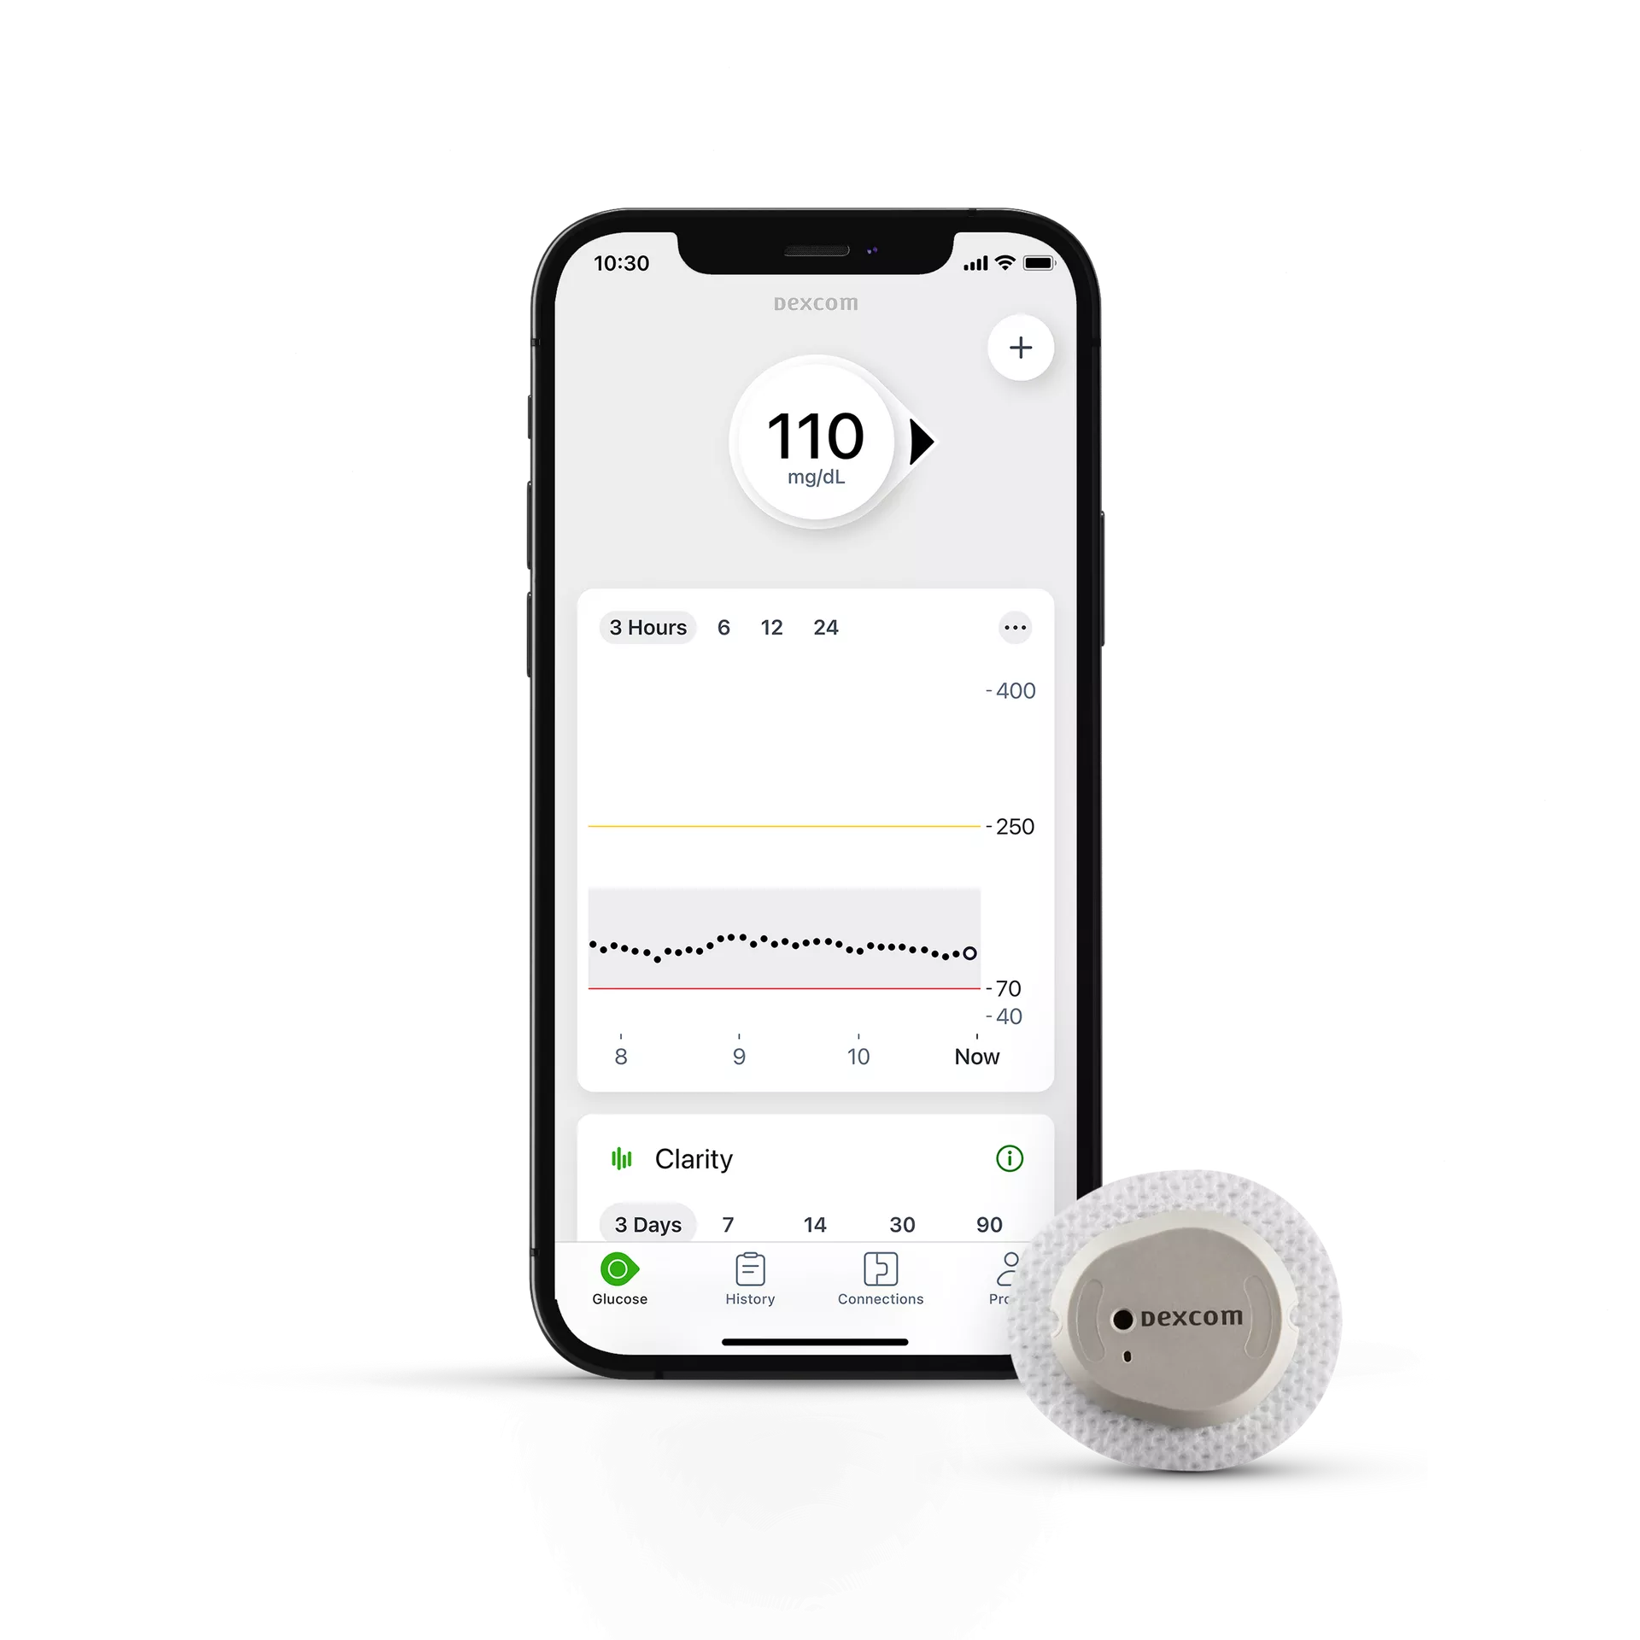
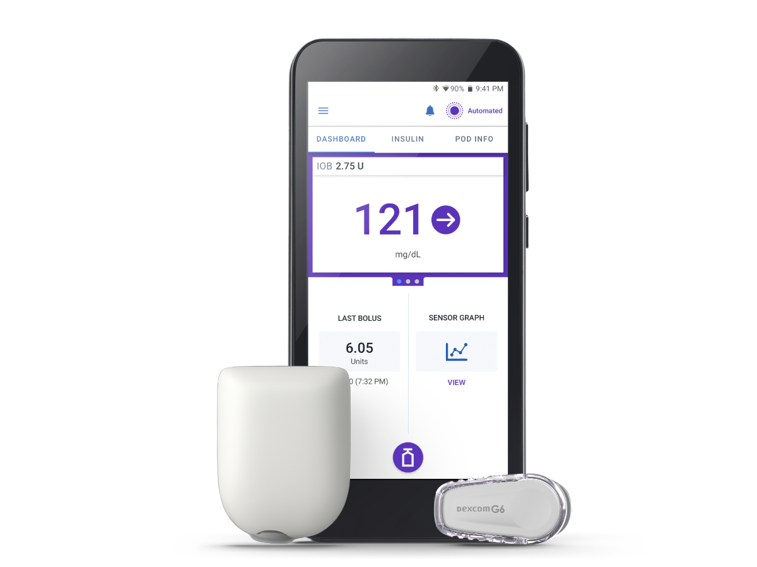
CONTINOUS GLUCOSE MONITERING
Nowadays, many devices are being used CGM like Dexcom, Omnipod, and Tandem are among the popular choices.

Slide 6
How these tools impacting public health ??
Remote Monitoring and Telemedicine
Data Analytics and Decision Support Systems
Patient Education and Engagement
Population Health Management
Interoperability and Care Coordination

Slide 7
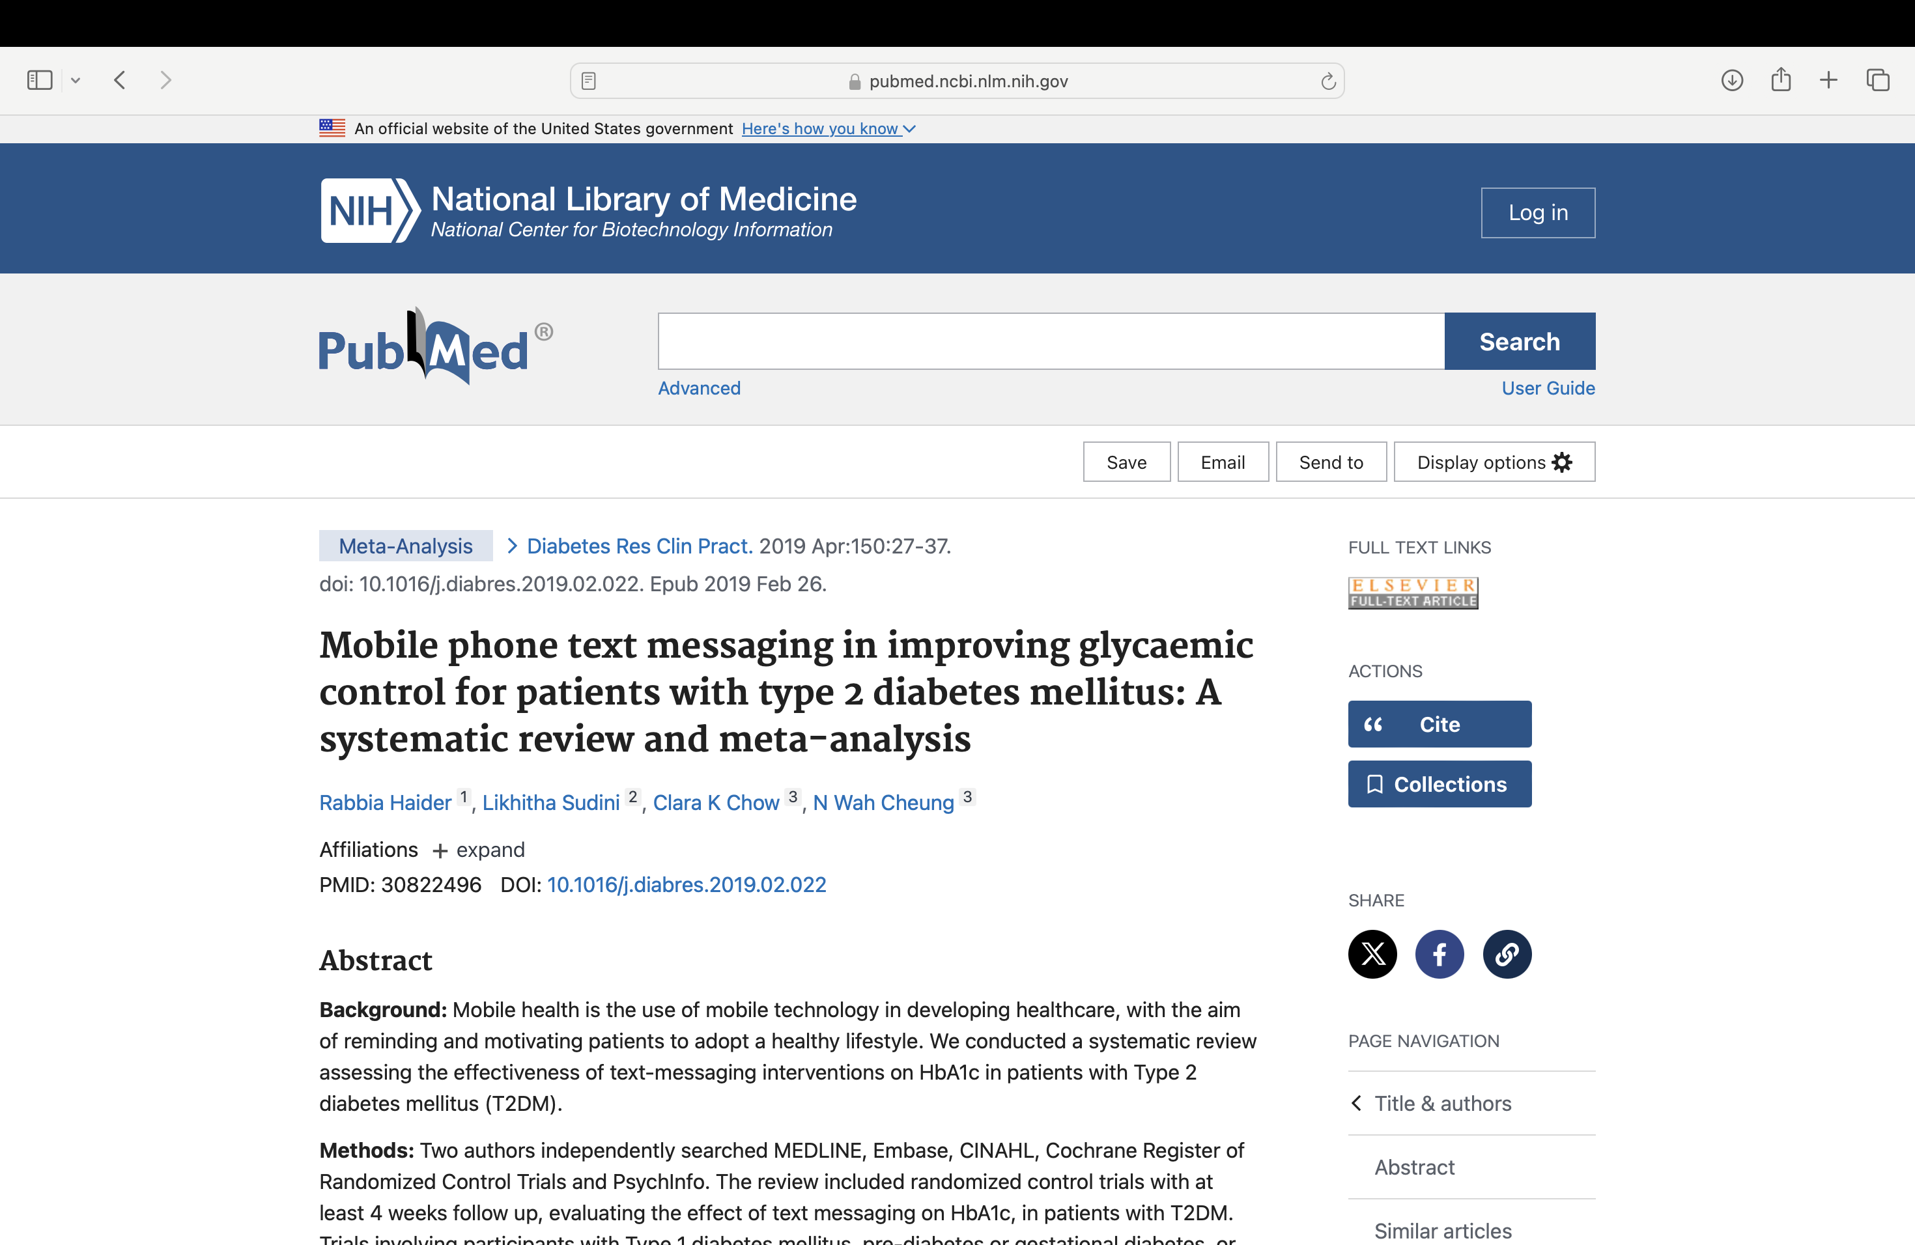
Key Research Insights
Mobile health (mHealth) utilizes mobile technology to promote healthcare and encourage healthy lifestyle choices. This systematic review assesses the effectiveness of text messaging interventions on HbA1c levels in patients with Type 2 diabetes mellitus (T2DM). Eleven randomized controlled trials involving 1710 participants were included. Studies primarily focused on educational and motivational messages. Meta-analysis of nine studies showed a significant reduction in HbA1c levels by 0.38%. Lifestyle-focused text messaging proves to be a cost-effective strategy for motivating T2DM patients to adhere to healthy habits. Additionally, personalized interventions through health information technology, such as mobile apps for dietary tracking and physical activity monitoring, have shown promising results in achieving reductions in diabetic management.

Slide 8
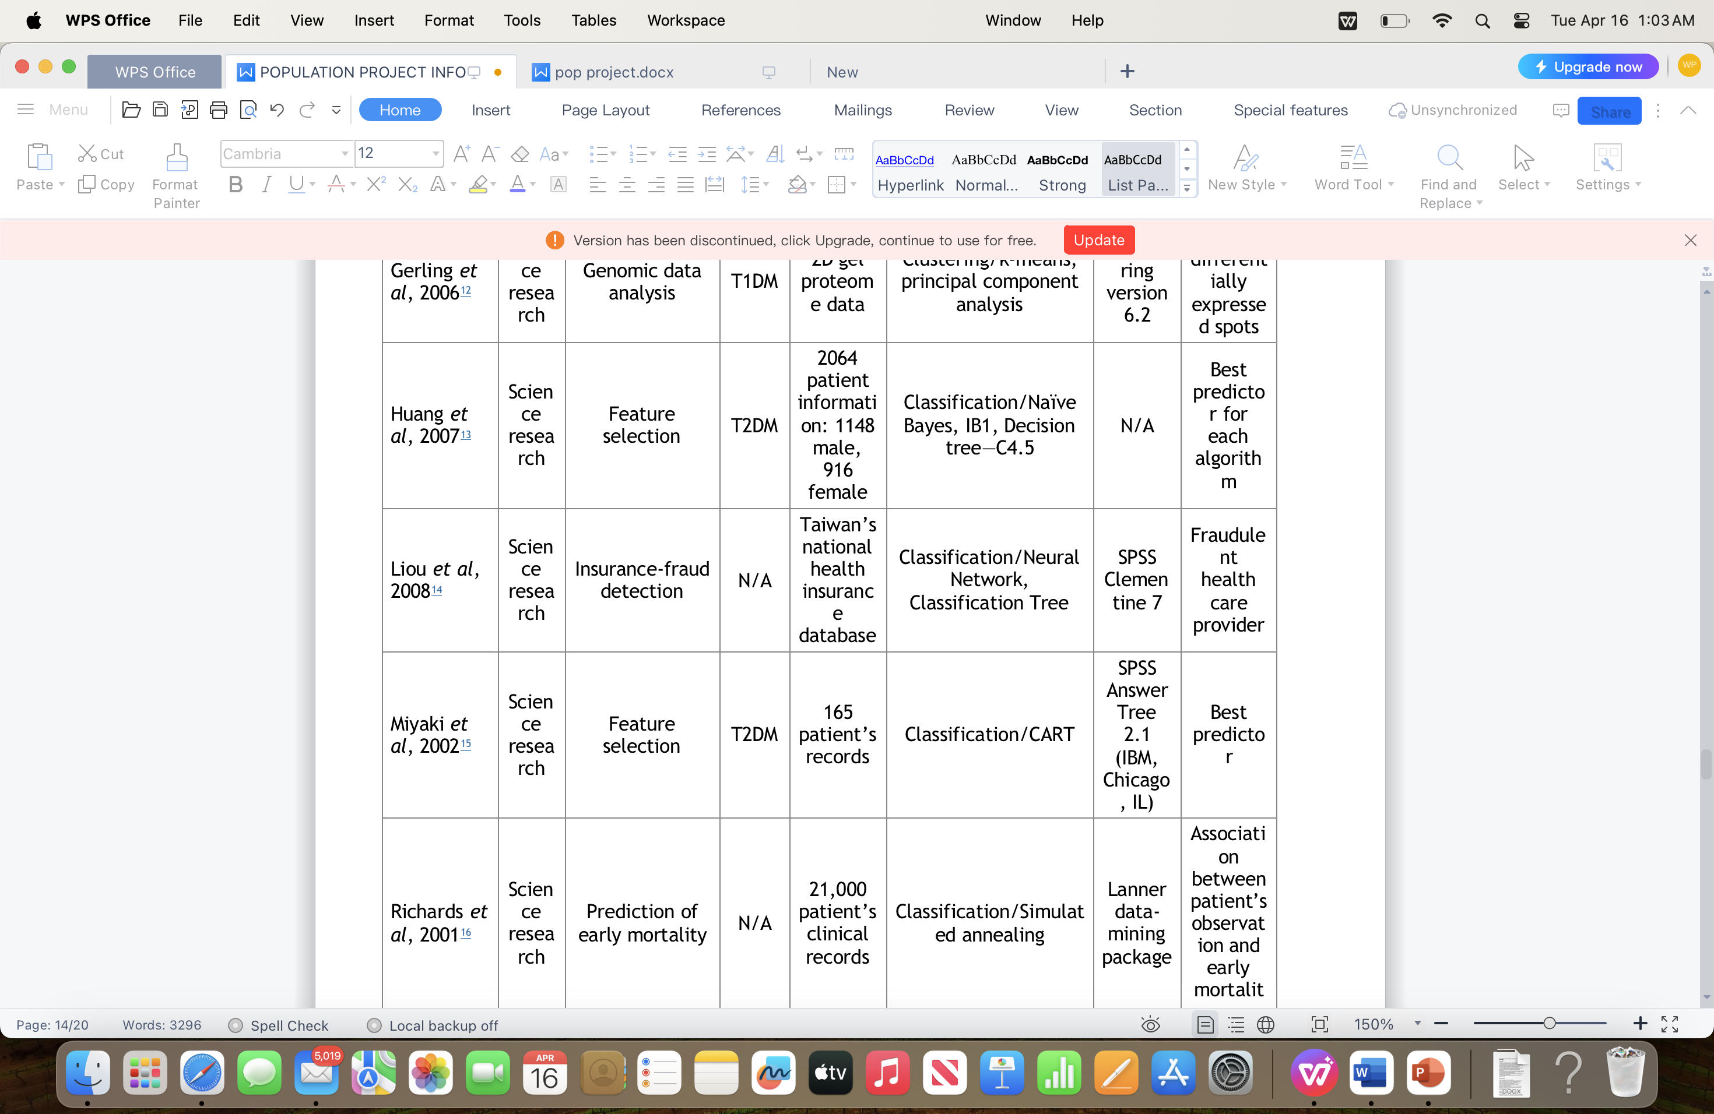
Data mining softwares in diabetis management
CART Data Mining Analysis: Age and Glycemic Control in Diabetes Patients
- Researchers used CART data-mining software to analyze data from 15,902 diabetes patients.
- Age emerged as the most significant factor associated with poor glycemic control (HbA1c >9.5).
- Surprisingly, patients younger than 65.6 years old showed worse glycemic control compared to older individuals.
-This discovery highlights the importance of targeting specific age groups in clinical interventions for better glycemic control.
- Data-Forest Software
- DataForest software used to predict next-morning fasting blood glucose (FBG).
- Study involved four type 1 diabetes mellitus (T1DM) patients over 150 days.
- Classification techniques applied to data including FBG, metabolic rate, food intake, and physical condition.
- Physical condition emerged as most correlated and predictive of FBG levels.
- Highlights importance of monitoring and addressing physical condition in managing FBG among T1DM patients.

Slide 9
Network analysis
Healthcare Flow Analysis:
Identifying system inefficiencies in diabetes care delivery.
Improving patient access and treatment timelines.
Adverse Drug Effect Analysis:
Assessing safety and effectiveness of diabetes medications.
Informing patients and providers about potential risks.
Insurance Fraud Detection:
Identifying fraudulent activities in healthcare claims.
Preventing financial losses and misuse of resources.
Clinical Guidelines Enrichment:
Updating treatment protocols with data-driven insights.
Tailoring guidelines for personalized patient care.
Prediction of Early Mortality:
Identifying factors linked to increased mortality risk.
Enabling early intervention to improve patient outcomes.

Slide 10
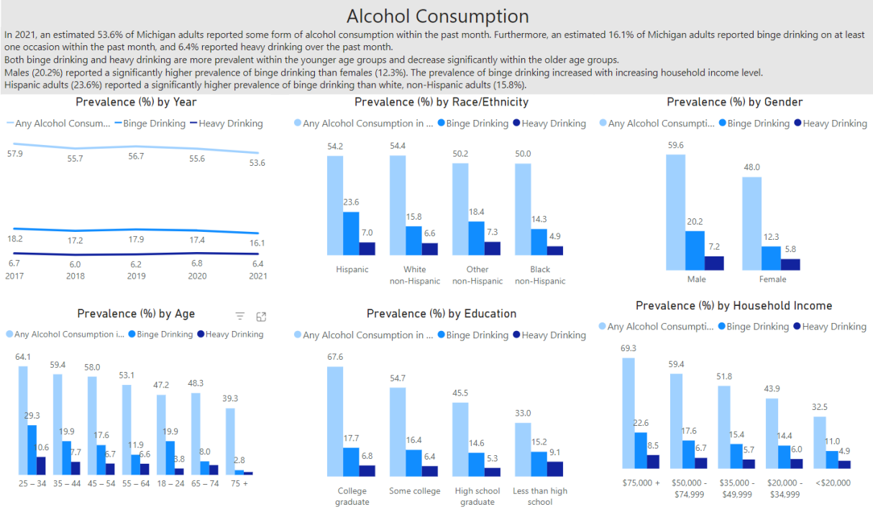
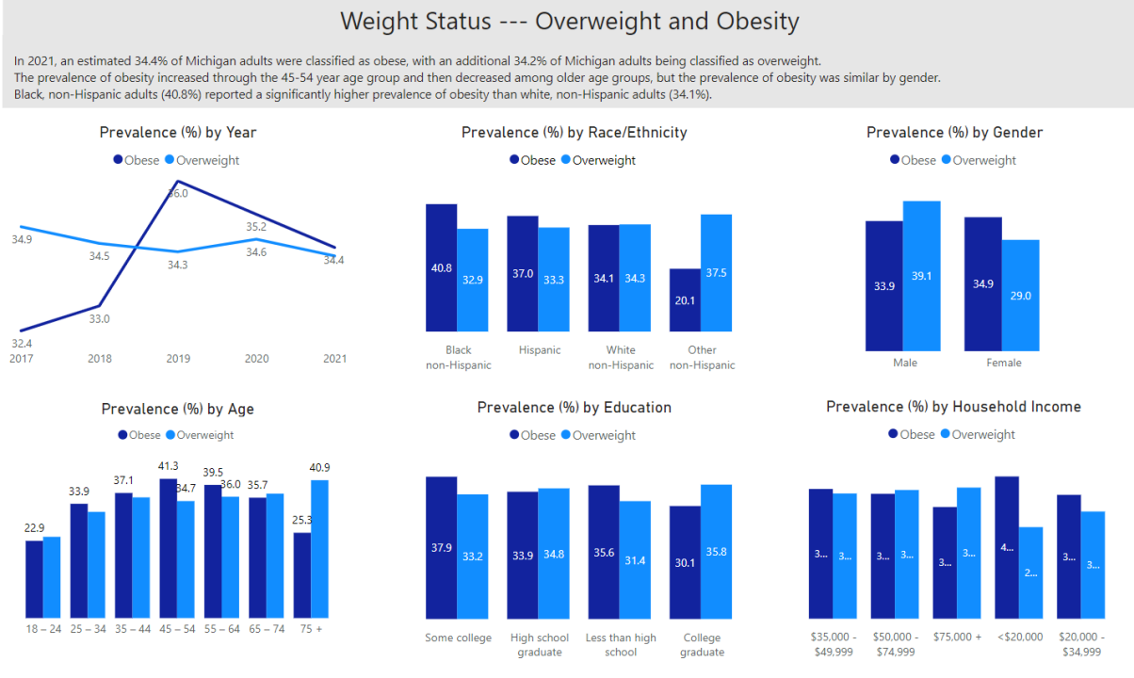
Temporal analysis
Prevalence Estimates for Risk Factors (2017-2021): Insights into health trends and challenges faced by the Michigan population.
Common Risk Factors:
Obesity
Sedentary Lifestyle (No Leisure Physical Time)
Alcohol Consumption
Cigarette Smoking
Hypertension Awareness
Lack of Routine Checkups
Age (Risk Increases with Age)
Metabolic Syndromes
Ethnicity (Certain Groups at Higher Risk):
African Americans
Hispanic/Latino Americans
Native Americans
Asian Americans

Slide 11
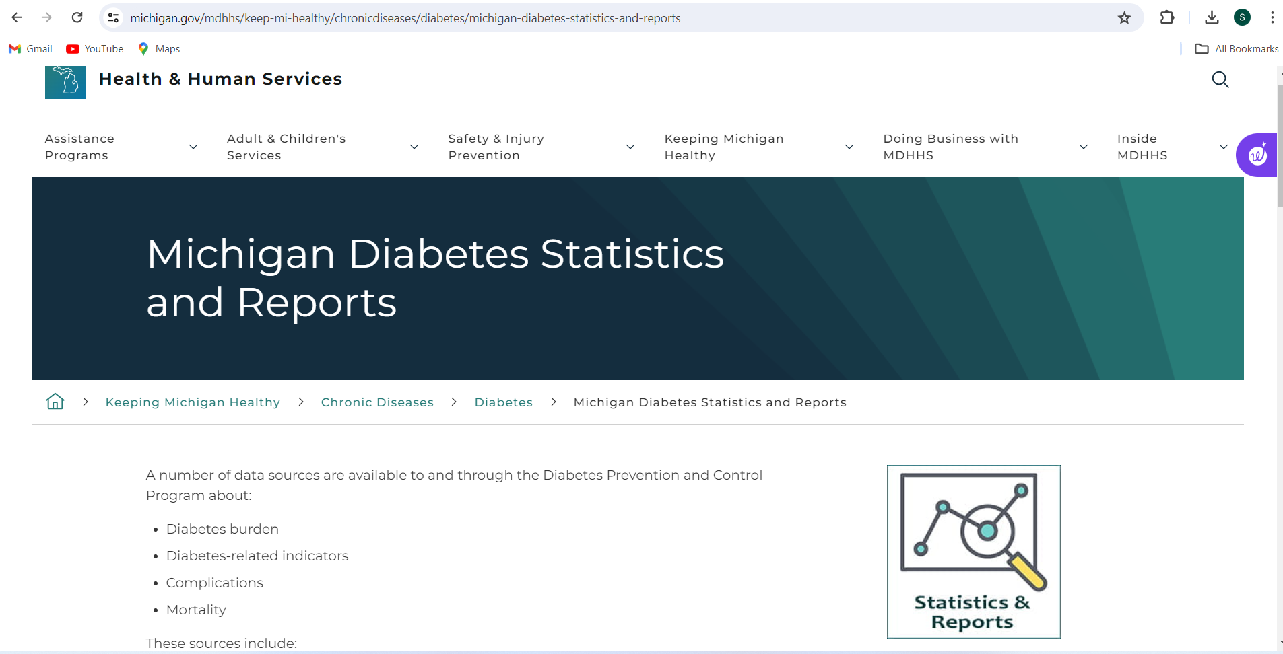

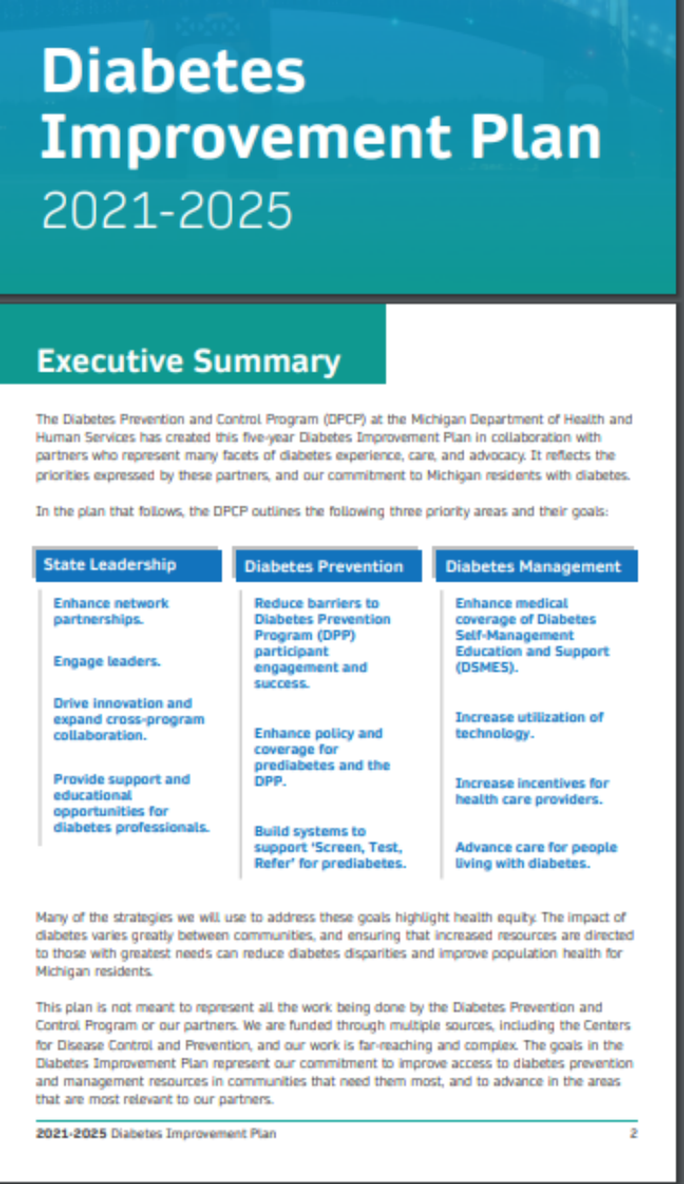
Michigan DPCP's Five-Year Plan:
Enhancing diabetes care through collaborative efforts
Primary Focus Areas:
State Leadership Objective:
Establishing partnerships and supporting professionals.
Diabetes Prevention Goals:
Enhancing accessibility of prevention programs.
Improving policies for prediabetes interventions.
Implementing early detection systems.
Diabetes Management Targets:
Enhancing medical coverage and assistance.
Utilizing technology and motivating healthcare providers.
Emphasis on Health Equity:
Prioritizing communities with the greatest needs.

Slide 12

Challenges
Data privacy and security concerns.
Interoperability issues between different health information systems.
Integration into existing healthcare workflows and infrastructure.
Limited access to technology among certain patient populations.
Ensuring the accuracy and reliability of data collected through informatics tools.
Cost-effectiveness and financial sustainability of implementing informatics solutions.
Training and education of healthcare professionals and patients on how to effectively utilize these tools.
Overcoming resistance to change and adoption of new technologies within healthcare organizations.
Addressing disparities in access to healthcare and technology among different socioeconomic groups.
Regulatory challenges and compliance with healthcare laws and standards.

Slide 13

Opportunities for new areas of research
Data Integration and Interoperability: Improve system compatibility for seamless data exchange in diabetes management.
Personalized Medicine: Utilize health informatics for tailored treatment plans considering individual factors.
Clinical Decision Support Systems (CDSS): Assess CDSS impact on evidence-based care, diagnosis, and medication management in diabetes.
Patient-Centered Outcomes Research: Engage stakeholders in analyzing patient-reported outcomes for improved diabetes care.

Slide 14

In short, using technology to manage diabetes looks promising. It helps doctors get patient information quickly, allows for remote monitoring, and supports making better treatment decisions. But there are problems like keeping data safe and making different systems work together. Despite these issues, technology can make a big difference in improving patient health and reducing differences in healthcare. To make it work well, doctors and patients need proper training, and the technology needs to fit into existing routines. Even though there are challenges like privacy concerns and not enough money, technology can help manage diabetes better by improving things like blood sugar levels(hbA1c) and complications like type 2 diabetes. In the future, we need to keep improving usage of health informatics tools for better diabetes care management.

Slide 15
Citations
Yoshida Y, J. Simoes E. Health Information Technologies in Diabetes Management Type2Diabetes IntechOpen; 2019. Available from: http://dx.doi.org/10.5772/intechopen.83693.
Sands, D. Z. (2023, December). Beyond the EHR: How Digital Health Tools Foster Participatory Health and Self-Care for Patients with Diabetes. American Journal of Medicine Open, 10, 100043. https://doi.org/10.1016/j.ajmo.2023.100043
Adaji, Akuh & Schattner, Peter & Jones, Kay. (2008). The use of information technology to enhance diabetes management in primary care: A literature review. Informatics in primary care. 16. 229-37. 10.14236/jhi.v16i3.698.
LA County Department of Public Health. (n.d.). http://publichealth.lacounty.gov/diabetes/docs/National_DPP_Research_Articles/Ahmad_Diabetes_Prevention_Health_Information_Technology_and_Meaningful_Use
Data-Mining Technologies for Diabetes: A Systematic Review https://www.ncbi.nlm.nih.gov/pmc/articles/PMC3262726/
Michigan behavioral risk factor survieliance system https://www.michigan.gov/mdhhs/keep-mi-healthy/communicablediseases/epidemiology/chronicepi/bfrs.
Effectiveness and equity of continuous subcutaneous insulin infusions in pediatric type 1 diabetes: A systematic review and meta-analysis of the literature https://pubmed.ncbi.nlm.nih.gov/33359572/
Challenges in Diabetes Care: Can Digital Health Help Address Them? https://www.ncbi.nlm.nih.gov/pmc/articles/PMC5019009/
Diabetes self-care in-the-wild: Design challenges for personal health record systems and self-monitoring technologies
https://www.emerald.com/insight/content/doi/10.1108/ITP-02-2013-0032/full/html
Predictive model for early detection of type 2 diabetes using patients' clinical symptoms, demographic features, and knowledge of diabetes https://www.ncbi.nlm.nih.gov/pmc/articles/PMC10808992/
Mobile phone text messaging in improving glycaemic control for patients with type 2 diabetes mellitus: A systematic review and meta-analysis https://pubmed.ncbi.nlm.nih.gov/30822496/
Using Continuous Glucose Monitoring in Clinical Practice
https://www.ncbi.nlm.nih.gov/pmc/articles/PMC7755046/
Michigan Behavioral Risk Factor Surveillance System

Slide 16

THANK YOU

